Slide 1
Let’s Review for…

Slide 2

AP Statistics!!!

Slide 3

Chapter 1
Review
Frank Cerros
Xinlei Du
Claire Dubois
Ryan Hoshi

Slide 4

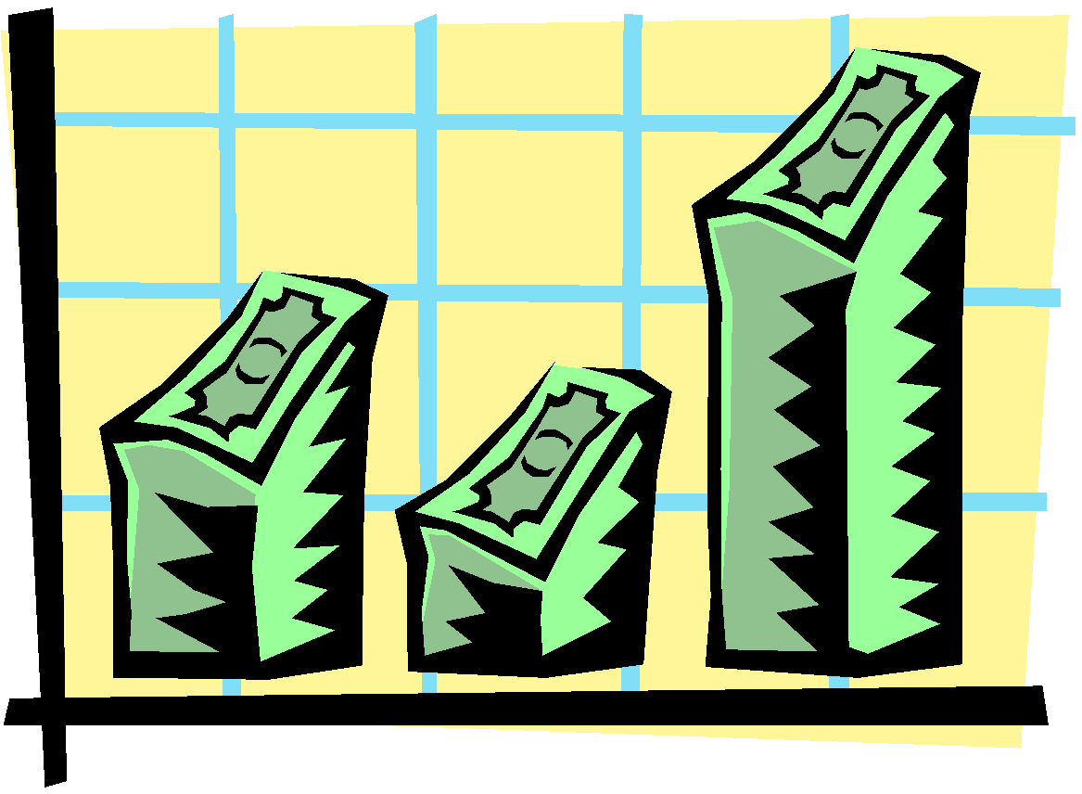
Introduction:
Individuals and Variables:
Individuals are the object described by a set of data. Individuals may be people, but they may also be animals or things.
A variable is any characteristic of an individual. A variable can take different values for different individuals.

Slide 5
1.1 Displaying distributions with graphs
A) Variables:
a. Categorical
Records which of several groups or categories an individual belongs to : can be presented using bar charts or pie charts
b. Quantitative
Takes numerical values for which it makes sense to do arithmetic operations like adding and averaging
c. Distribution
A variable tells us what values it takes and how often it takes these values
B)

Slide 6
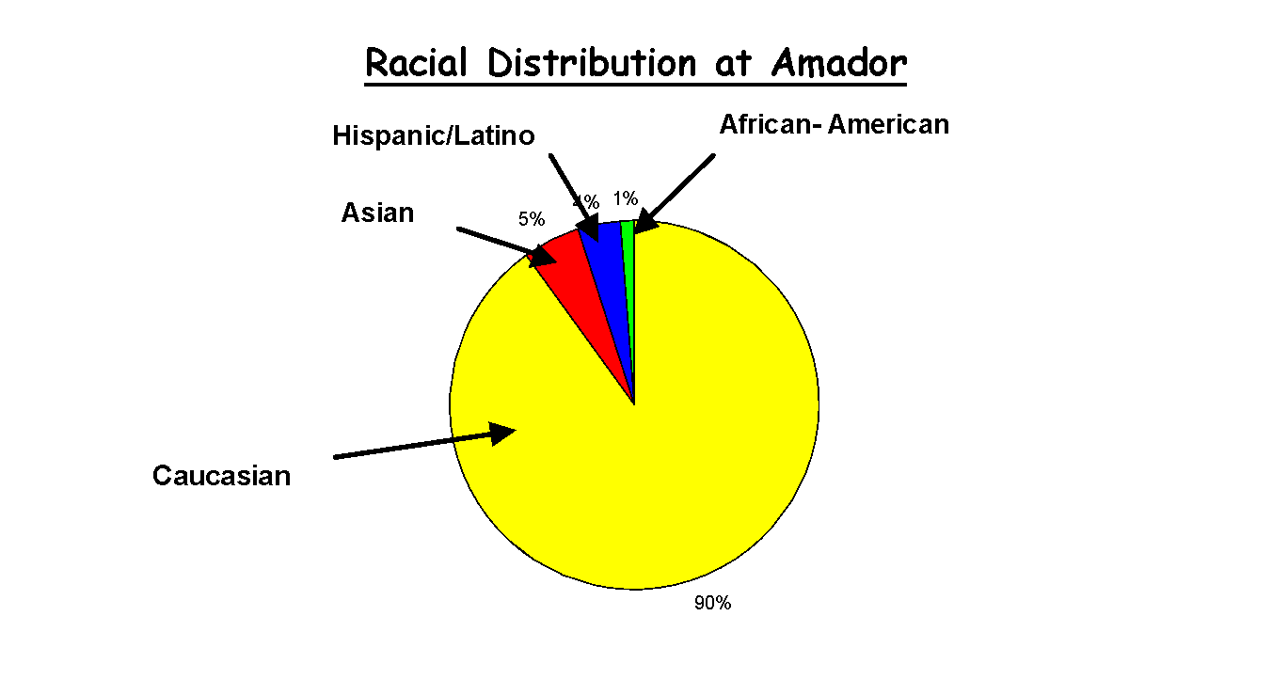
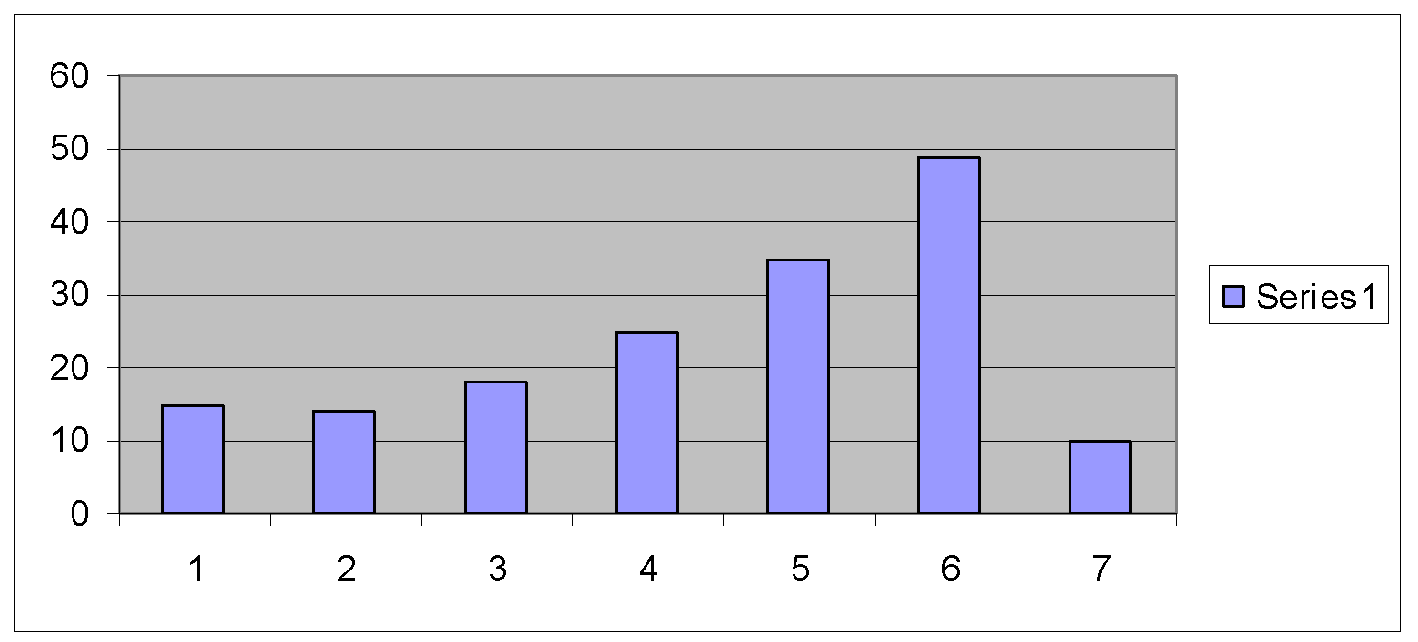
Categorical Graphs:
Pie Chart:
Bar Chart:

Slide 7

Stemplot
Separate each observation into a stem consisting of all but the final (rightmost) digit and a leaf, the final digit.
Write the stems vertically in increasing order from top to bottom, and draw a vertical line to the right of the stems.
Go through the data writing each leaf to the right of its stem
Rewrite the stems, rearranging the leaves in increasing order

Slide 8
Character Stem-and-Leaf Display
Stem-and-leaf of C1 N 1 12 0
1 13
1 14
5 15 0000
10 16 00000
(5) 17 00000
13 18 000
10 19 000
7 20 0
6 21 0
5 22 00
3 23 0
2 24 0
1 25 0
NEATO!!

Slide 9
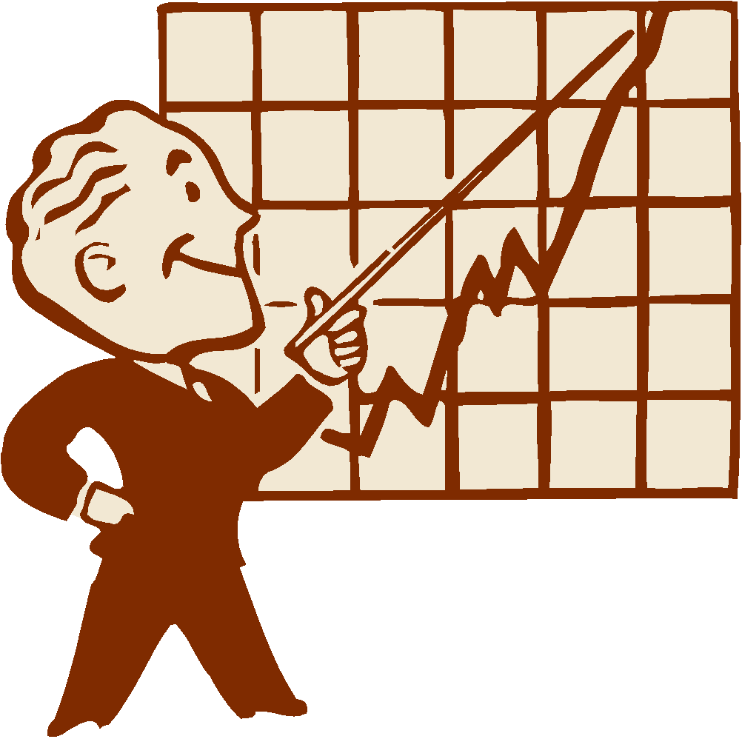
Time Plot
This plots each observation against the time at which it was measured
Time scale = horizontal axis, variable = vertical axis
If not too many points, connect them
When examining a time plot, look for an overall pattern and for strong deviations
A trend could appear which is a long term upward or downward movement over time

Slide 10
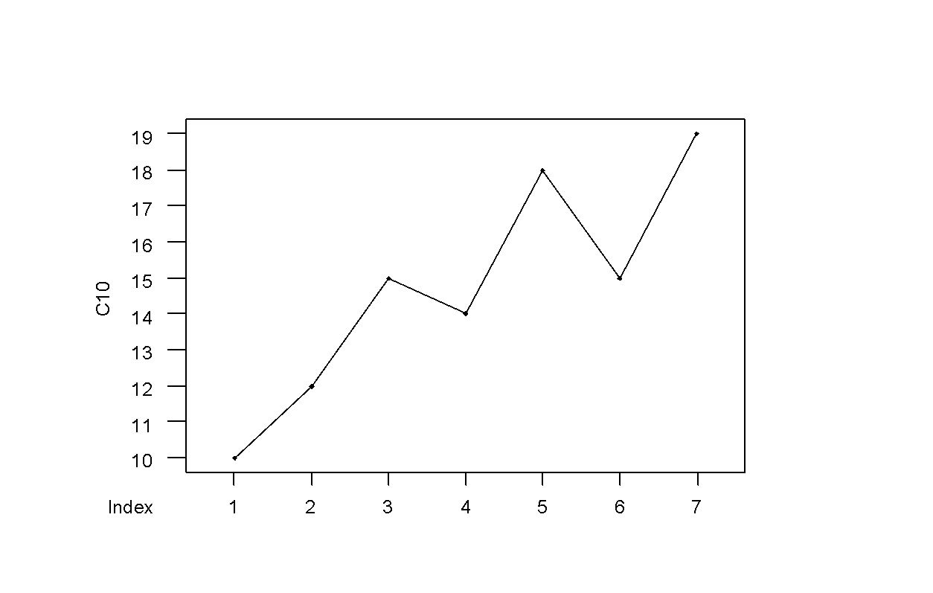

TIME

Slide 11
Interpreting Histograms:
Look for an overall pattern and also striking deviations from that pattern
For histograms, the overall pattern is the overall shape of the distribution
OUTLIERS:
An individual observation that falls outside the overall pattern of the graph
Overall Pattern of distribution: To describe it, give the CENTER, SPREAD, see if the distribution has a simple shape that can be described in a few words

Slide 12
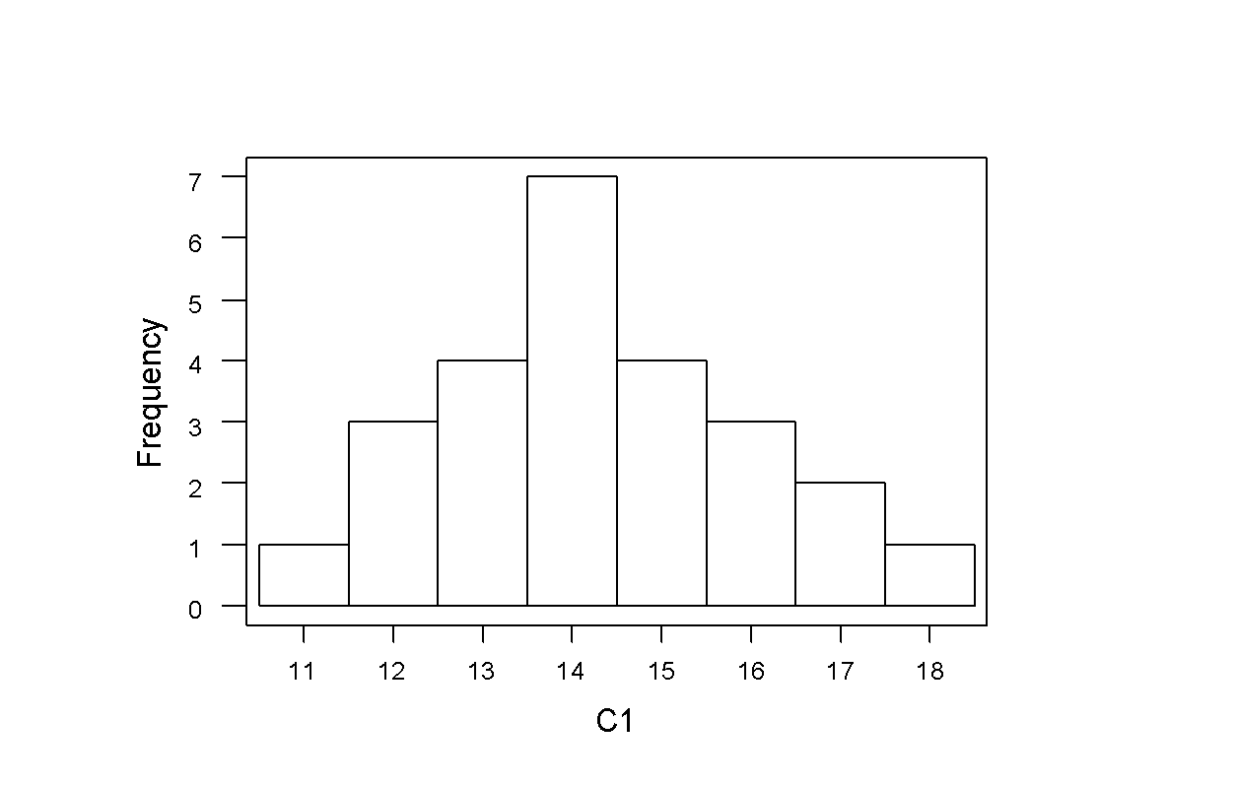
NORMAL

Slide 13
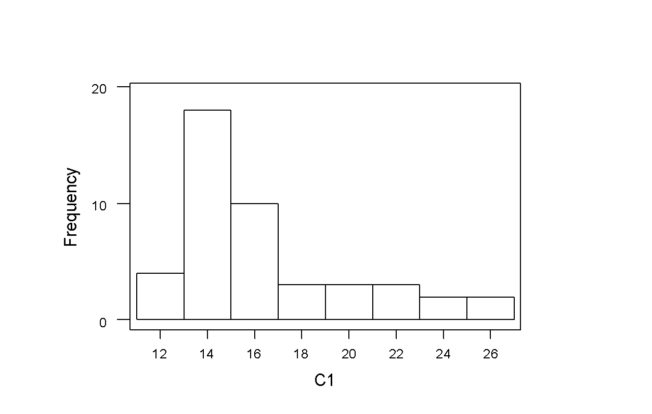
Skewed Right

Slide 14
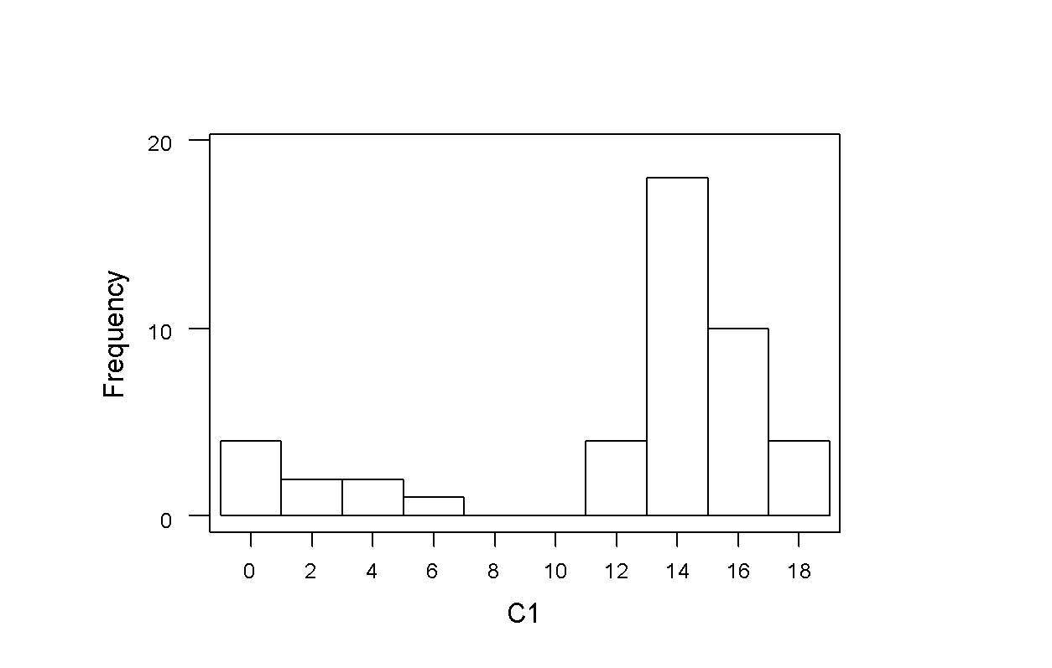
Skewed Left
Skewed Left

Slide 15
The Mean—x
This is the arithmetic average, often called x or y (“x bar” or “y bar”). It is found by adding n number of observations and then dividing them by n. The formula is: 1/n Σ x_{i} Sigma or ‘Σ’, is the sum described above
1.2
This is the middle value of the observations when they are arranged from the smallest to largest. If there are 2 middle values, the median is the average of the 2 values, or (n+1)/2 observations from the bottom of the best.
The median is used to give a “typical value” when strong outliers exist in data as these outliers influence the mean, but not the median. The mean is used to give the true arithmetic average value.

Slide 16
quartiles
Range is the spread of data, or the highest minus the lowest value.
Quartiles mark the middle of the data. The first quartile, or “Q” (Quartile 1) is the median of observations left of the overall median when all values are arranged from smallest to largest. Q₃ is the median of values right of the median.
The inner quartile range includes the values from Q₁ to Q₃ .
The 5 number summary is simply:
Minimum, Q₁, M, Q_{3,} maximum

Slide 17
A boxplot is the graphical representation of the 5# summary. Draw a numberical scale and then title the data on the other axis. Mark the median first, then Q₁ & Q_{3.} These values make up the box, the max and minimum values are the tails/whiskers.
Standard deviation measures spread by how observations vary from their mean.
Standard devation = s
s²=variance
s²=Σ(x_{i} + x₂) ²/n-1
(s=√ s²)
n-1 is the degree of freedom of s or s²
Notes: s is the only in reference to spread about a mean
s is influences by outliers
s=0 only if there is no spread

Slide 18
density curve
Always remains on or above the horizontal axis & has a total area (1) underneath it the area gives the proportion of observations that fall in a range of values.
Mean of density curve ‘μ’ (instead of ‘x-bar’)
Standard deviation of density curve ‘σ’ (instead of ‘s’)
Mean, median, quartiles can be located by the eye.
-μ is balance point
-medians divides area under curve in half
-σ cannot be located by eye in most curves
-mean & median are equal for symmetric
-mean of skewed is located farther toward the long tail than is the median
-normal distributions are described by normal curves

Slide 19
standardized observations:
z= x-μ/σ
all normal distributions satisfy the 68-95-99.7 rule (it describes what percent of observations lie within one, two, third standard of the mean
standard normal distribution
N(0,1)
Mean=0
Standard deviation=1

Slide 20
THE END!!!!!!!!!!
ZZzzZZzzZZZzzz

